Slide 1
Anxiety Workshop for Parents

Slide 2
Workshop aims
Who is the MHST?
What is anxiety?
When is anxiety a problem?
Anxiety disorders
What can we do?
Signposting and what next?

Slide 3
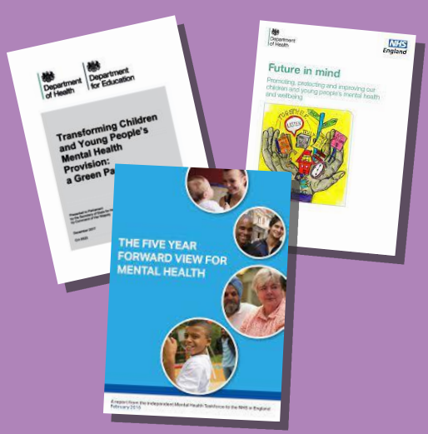



What is the MHST?
Notes:
YS and NHS foundation trust are co-deliverers of the MHST contract for Somerset. We work with schools to provide early MH support and develop a WSA to mental health and wellbeing.

Slide 4
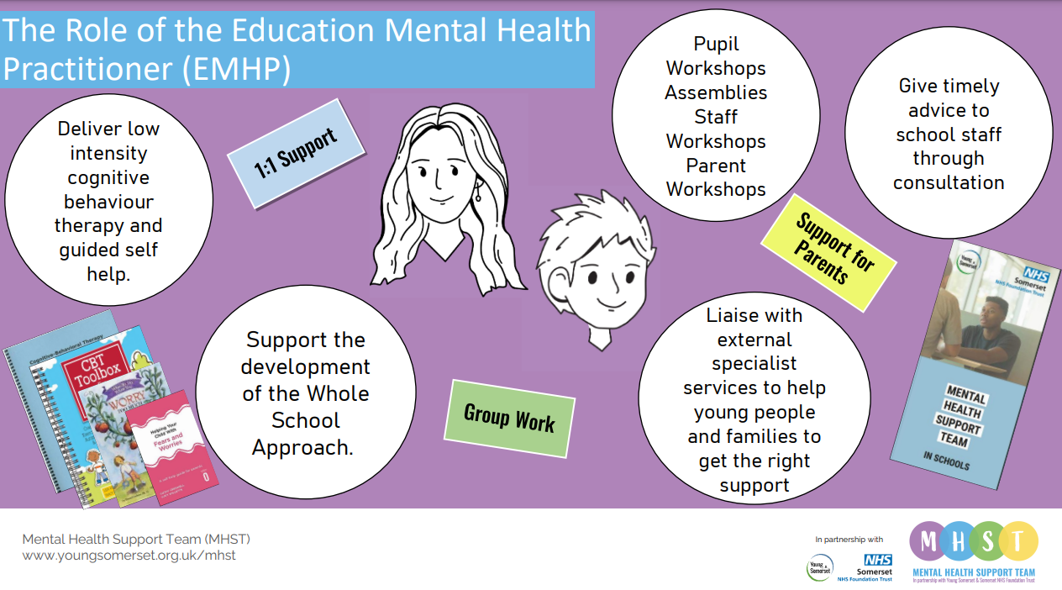

Slide 5
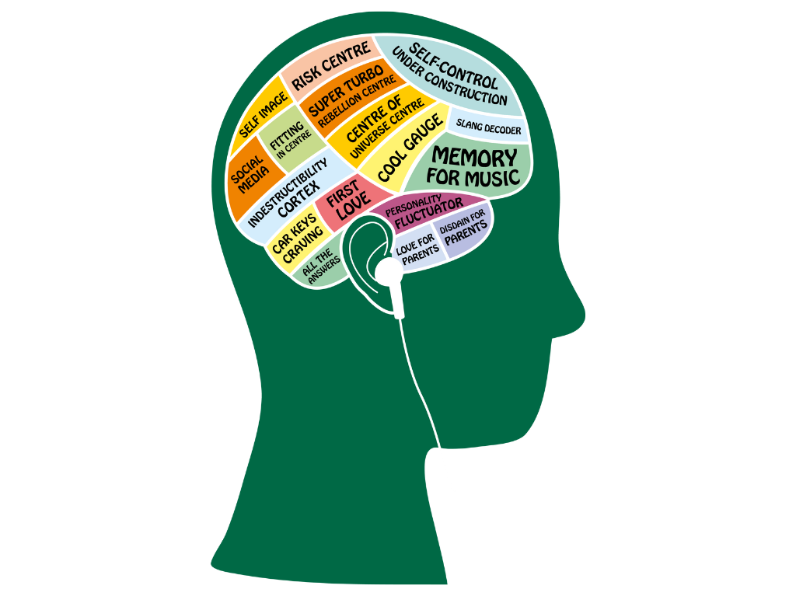


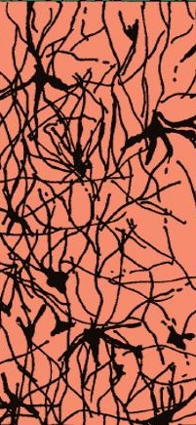
Synapses connect cells within the brain (called neurons) so that messages and information can be sent. These images show the number of synapses in a brain at 3 different ages:
      Birth
      7 years
      15 years
A
B
C
But which is which?

Slide 6
Did you get it right?
Birth
7 years
15 years
Notes:
Pruning – brain has a sort out, which will mean that some of the skills we've learnt to manage our emotions get cut away, so we'll find keeping a lid on everything difficult.

Slide 7
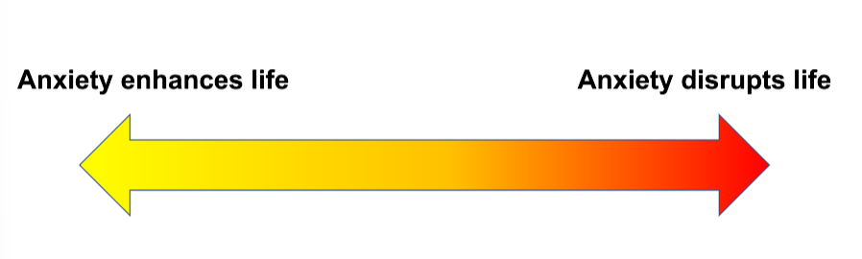
Anxiety is a normal, human feeling as a response to danger. It is essential and useful – however sometimes the anxiety does not match the level of danger, that’s when anxiety can become a problem.
We don’t want to eliminate anxiety entirely – but manage it
Notes:
We need anxiety – is it enhancing life, keeping us safe, helping us prepare and perform?
But it can be negative! (often? Lasts long (longer than the trigger, does it cause barriers to doing things they like and need to do, and does it exceed the level of threat? Difficult to control)
-Is it disproportionate?
Is it dangerous?
- eg bullying
We DON’T want to eliminate anxiety – we just want to be able to better manage it

Slide 8
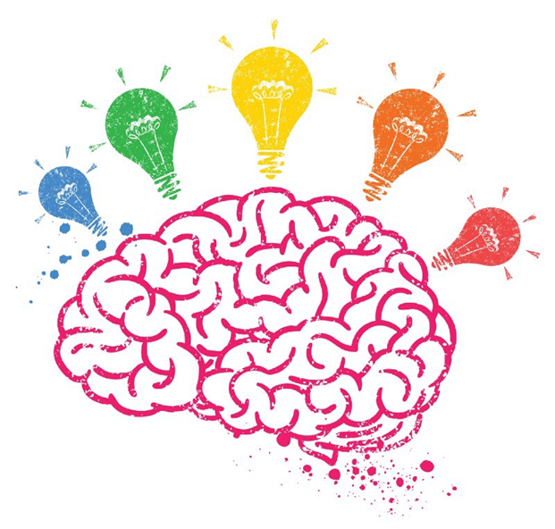
What things might our children fear or worry about?

Slide 9
What might we see as a reaction to anxiety?
Notes:
How parents respond can assist their child to overcome which fears – emotion coaching can support this.

Slide 10
Thoughts:
E.g. “What if I get bitten by the dog?”
Overestimating danger.
Underestimating ability to cope
Bodily Sensations:
Headache
Tummy ache
Sweaty palms
Heart beating fast
Dry mouth
Behaviours:
Avoidance
Seeking reassurance that it will be okay
Being withdrawn or “acting out”
Distractions
Notes:
Thoughts are the FUEL of anxiety

Slide 11

Different types of Anxiety
Anxiety doesn’t come in one shape or form.
  People have individual differences or experiences
  There can be different or interacting causes
  Anxiety can vary in intensity or severity
  People may have different maintenance factors
Specific Phobia
Panic Disorder
Obsessive Compulsive Disorder (OCD)
Generalised Anxiety Disorder (GAD)
Separation Anxiety
Social Anxiety

Slide 12
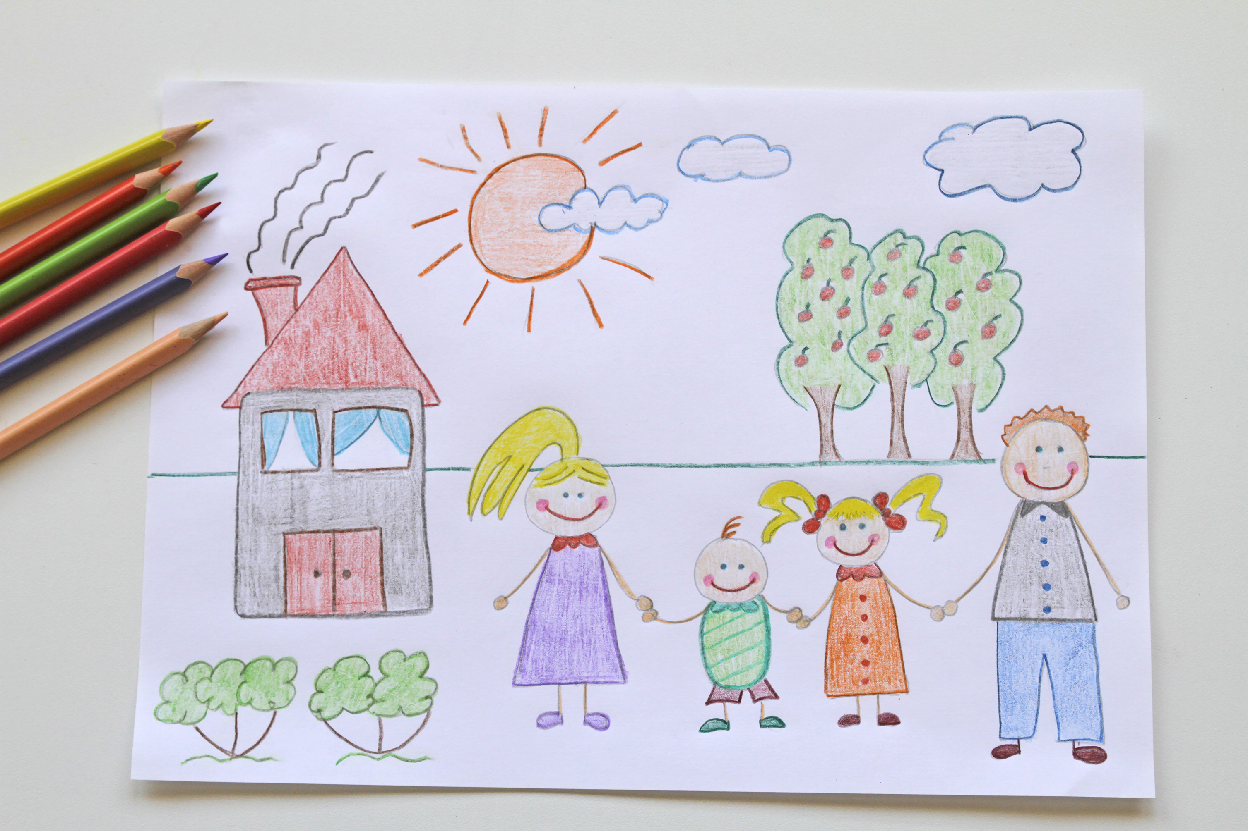
Where does it come from?
Life events or experiences
Genes
Learned behaviour
Temporary circumstances
Or a combination of these

Slide 13
What maintains anxiety?
Avoidance
Missed opportunities for coping
Safety behaviours
Reassurance
Other people’s reactions / responses
Lack of confidence – specifically in their ability to cope
Lack of independence
Worries going unchallenged
Notes:
Avoiding causes short term relief – but this enhances that avoidance is the answer to solving the issue
Missed ops for learning - if the danger is disproportionate, we need to be actively learning this
Safety behaviours can stop us learning. If we do something new and we think we only succeeded because of X we are missing learning
Reassurance – important and natural, anxiety is horrible and watching it can be even worse.
I want to say – it’s okay and important to reassure, but as independence grows, we need to help them take a curious approach – especially if seeing a pattern
ACKNOWLEGE the FEELING
(eg reassurance 1st time, 2nd time, well what do you think, how can you manage this? Problem solving? / lets find out)
-problem solving
-app for convos

Slide 14
What has worked for you?

Slide 15
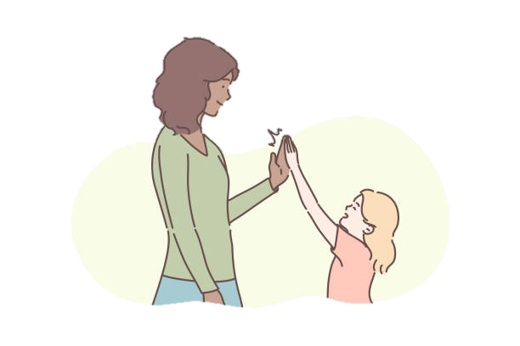
What can we do?
Talking about anxiety
Grounding
Encouraging learning
Think about reassurance
Worry management

Slide 16
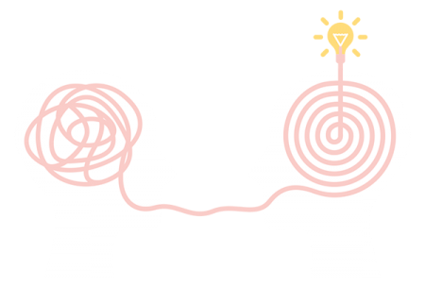
Talking about anxiety
Communication is key – everyone communicates differently (emoji cards, videos, 5-point scale)
Normalise anxiety, recognise and name it
Be curious – what is the “feared consequence”? (WIN)
Praise and Reward
Modelling curiosity
Notes:
Be curious – thoughts are the fuel to anxiety / we need to learn what they are to know what the YP needs to learn to overcome them
Think carefully about what questions you ask
Ask them to scale how their day has been...1-10, ask about differences
Use WIN (I Wonder, I imagine, I notice)
Normalise - I could see that ? was upset today but still went in, what did they do to help them? It’s normal to worry about your spellings test, it shows you care about doing well.
Encourage independence - small things, choosing how they have their hair, what clothes to wear at the weekend. Anything that can help them to see what they are capable of..
Praise and Reward - I’m sure already you notice all the positive things your children do - highlighting these positives more is helping to increase their self belief - make sure it’s specific e.g. “you were great going into school today” could be “ When you went into school today you left me at the gate and I really liked that we hugged and you went in without tears” Letting them know exactly what they did that was good
Rewards - mixed responses from this - is it bribery? Are they only doing it because of the reward? It doesn’t have to be expensive or even cost anything….watch a film together, a friend to tea, a sleepover, baking together

Slide 17
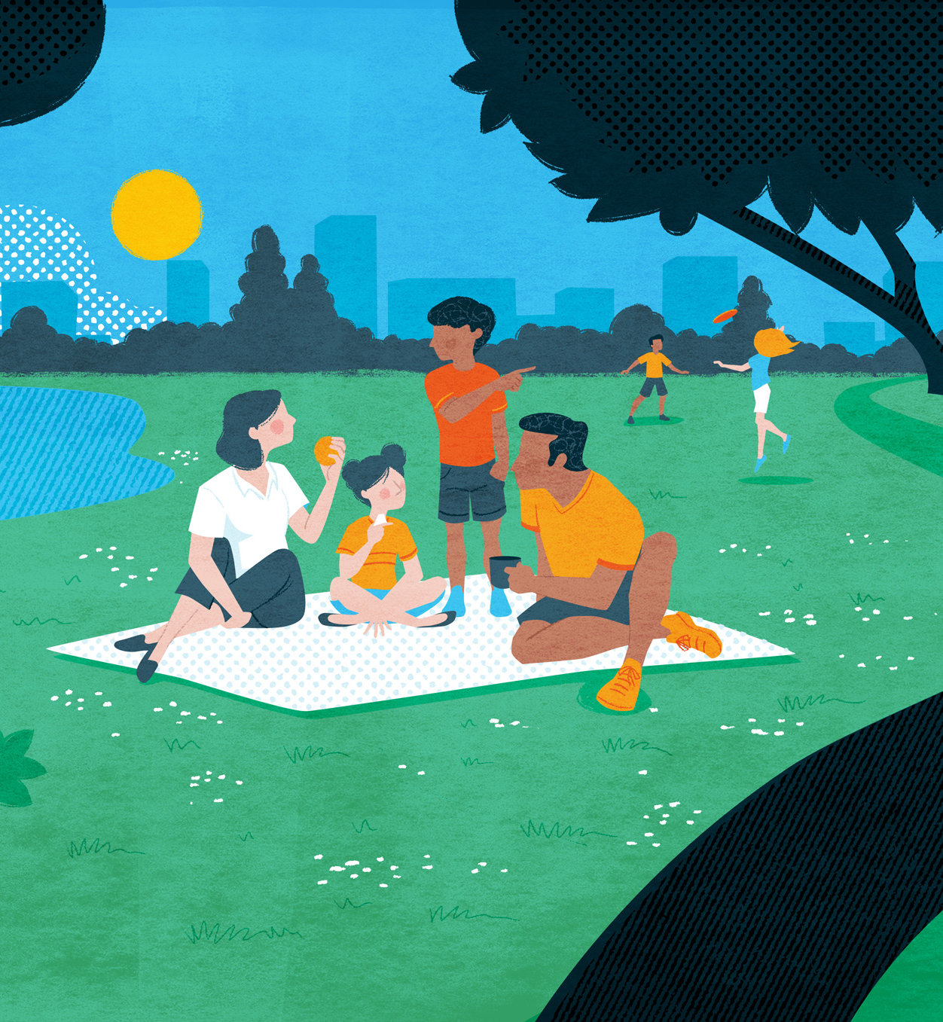
Grounding and relaxation
  Distraction
  Breathing techniques or 5 4 3 2 1
  Diffusion
  The 5-point scale
  Free apps:
    Clear Fear
    Chillpanda
    Mindshift
    Molehill Mountain
  Exercise, sleep and nutrition

Slide 18
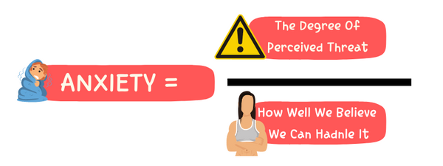

Encouraging Learning
Managing avoidance
Avoidance makes sense – we will want to avoid something we think is dangerous
We know what works – we need new information to make a change
“Take our thoughts to court”
Notes:
Anxiety lessens with repeated exposure
Calmness and confidence are not just natural emotions – they are skills that we learn
We overestimate the danger
We underestimate our ability to cope
We want a fair and proportionate response to the danger
We can think of this as “taking our thoughts to court”

Slide 19
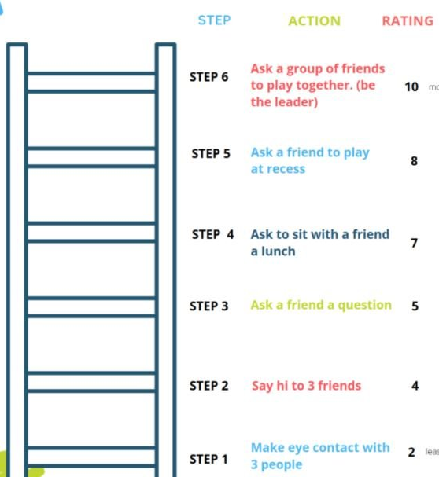
Encouraging Learning
Gradual exposure laddering
This should be planned out
We are TESTING a prediction about a worry
Small steps LED by child – gently testing these
Use “easy wins” and/or rewards
Be aware of coping strategies
Not for worries with real dangers
Notes:
Gradual exposure to situations help us to “habituate to anxiety” over time
This is not about a “leap of faith” or jumping in headfirst
Allow for new information – learning and “pruning” our synapses
This should be planned and a step-by-step approach – starting with things the child can already do
(rewards can be useful)
Be mindful of safety behaviours
E.g. chewing gum made me feel less sick – it helps but that doesn’t teach us anything about the actual situation
Be aware of REAL DANGERS – if there is risk (e.g. bullying) this needs direct intervention, not anxiety support

Slide 20
Thinking about reassurance
  Reassurance as a coping strategy
  Reassurance is natural and important
  BUT balance is important to avoid increasing anxiety
  We should always respond to distress
      Make a clear plan
      Follow through on that plan
      Be consistent and praise
Notes:
Don’t have all the answers
Acknowledge upset
We have some apps for self-soothing, might prompt that as a possibility to encourage independence
– we can be supportive without being at beck and call

Slide 21
Having conversations
  Listen - your most powerful tool
  Be aware of your own feelings
  Resist the urge to downplay or dismiss, or fix
  Accept - all emotions and feelings are okay
  Empathise and validate.
  Reflect back what you have understood and label their emotions
  Don’t be afraid to ask the ‘big’ questions
  Involve your child in the next steps
Notes:
Mindful Emotion Coaching Beginner Level – All Emotions are OK (wpcomstaging.com)
use code Alpiri
Emotions are most damaging when we are on our own with them.
Listening: Use example of venting to a friend – you just want them to listen. Stop yourself from jumping in and fixing. Try not to make assumptions or judgements. Don’t be afraid of silence. They may need time to find the right words – may have lots of noise in their heads.
Don’t be afraid to ask them directly if they are thinking of taking their own lives, or have they thought of suicide if that is a concern of yours.
WIN. I wonder, I imagine, I notice
Resources:
If you have particular concerns over issues such as self injury or disordered eating, we have information booklets here that will be able to guide you in those specific circumstances
Every child needs three key things:
Love
Security & safety
Understanding
Emotions are only damaging when we feel alone with them.

Slide 22
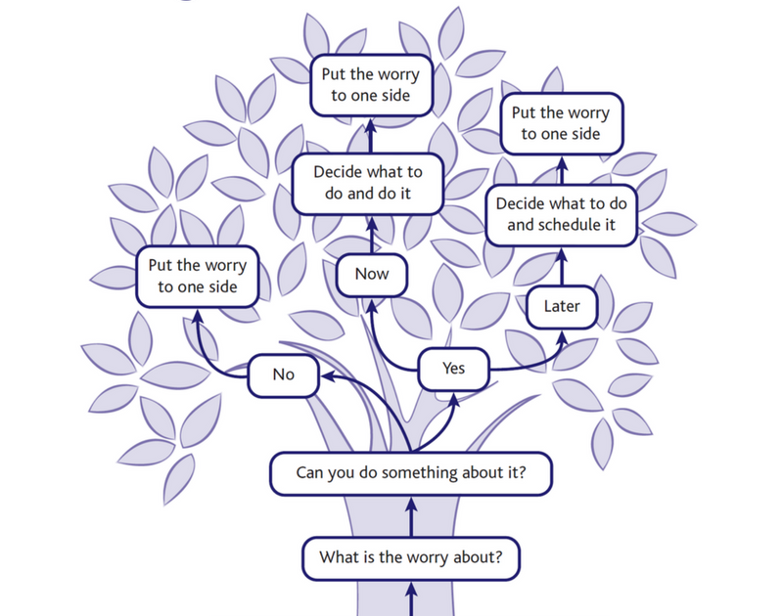
Worry management
Notes:
Worry management

Slide 23
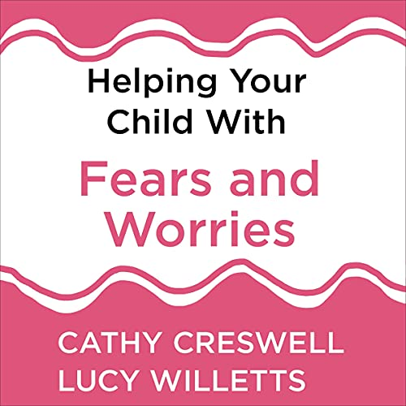
What next?
  There is no one-size fits all approach
  Self-compassion – we all make mistakes
  Helping Your Child With Fears and Worries
  -Cathy Creswell and Lucy Willetts
  Emotion Coaching or Tuning Into Kids
  GP
  Signposting
Notes:
Worry management

Slide 24
Summary
Anxiety is normal and important – but can be a problem if chronic or causing barriers
Find a communication style that suits your child
Be curious about the “underlying feared consequence” of a worry
Encourage independence and “having a go”/ experimenting
Review afterwards and praise the EFFORT (not outcome)
Seek support if it is having enduring impact
Notes:
Importance of catching MH concerns early – they may not even realise
Spotting a problem early, providing support and asking for help if you need it can prevent a child from developing certain problems or difficulties.
Ask the group: when do your children choose to talk to you?
Talk about your own emotions – and how you resolve them
Be careful not to make your children responsible for your emotions
You’re children may reject you or push you away, keep reminding them that you’re there for them, you support is unconditional

Slide 25










Free, confidential online support and chat service for ages 11 -24
Mental health information and support and Helpline (Mindline)
‘Tell Mi’ App – Peer, and Specialist Support – Fully moderated and SFT Commissioned - Online community, open counselling and integrated signposting
Young people’s emotional wellbeing and mental health advice and support.
Parent helpline.
Support for families to improve sleep
Free e-learning resources. Support children and young peoples emotional and mental wellbeing
Mental health resources for parents and young people
1:1 Low Intensity Cognitive Behavioural Therapy
Charliewaller.org
Resources and advice on anxiety, depression and more.
Cypsomersethealth.org
Notes:
Sarah
Additional Resources
‘Pooky knightsmith Mental health’ – youtube page, videos for parents & young people about emotions, mental health etc
Staff in school
Youngminds parent lounge youtube channel – teen behaviour, school refusal, anxiety, depression, anger, self-harm

Slide 26
End
Additional optional slides for questions:

Slide 27

Boost self esteem
Remind your child what you love about them
Increase avenues to gain self-esteem
Notice the good

Slide 28

Get moving
Physical Activity reduces the risk of mental health problems such as anxiety or low mood
Exercising outdoors can reduce feelings of anger and fatigue
Notes:
Getting moving – walking, running, playing sport, dancing, fidgeting – can help release built up energy or help increase energy if we’re feeling low.
Even better if we can do this outside.
Build this into a routine
Good for physical health but also our mental health
physical activity may reduce the risk of mental health problems, like anxiety or depression.
And when done outside (rather than indoors) can reduce feelings of anger and tiredness.
We don’t even need to do it for long! Exercising in green spaces for as little as five minutes was found to improve mood and feelings of self-esteem.

Slide 29
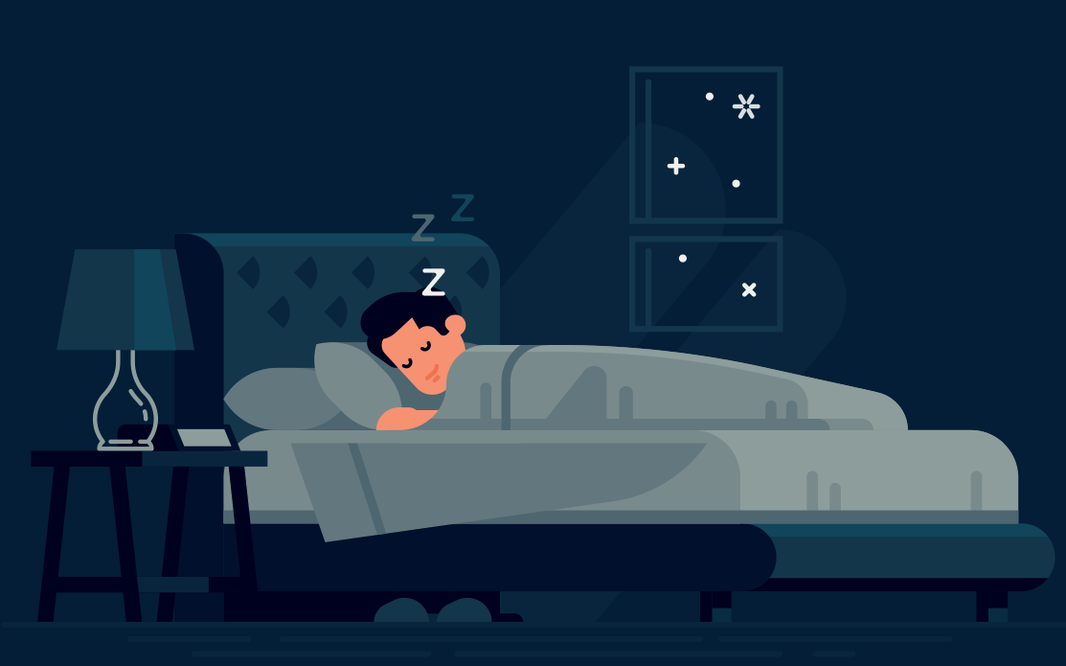

Improving sleep
68% of teenagers don’t get enough sleep
Much more likely to experience low mood, anxiety and be irritable
Natural light
Routine
Devices
Sleep environment
Exercise
Avoid caffeine
Notes:
The most important one – if you can do one thing to improve mental health – its get quality sleep. Sleep is vital for our physical and mental health
Hands up: Who feels like they don’t get enough sleep?
68% of teenagers don’t get enough sleep on school nights. Your bodies release melatonin later, so you feel awake long past bedtime.
We need sleep to recharge our brain. When you’re tired you much more likely to experience low mood, anxiety and be irritable.
1 quick way to improve symptoms of anxiety – better sleep
Among those aged 5 to 22 years, 58.9% with a probable mental disorder reported having sleep problems. Young people aged 17 to 22 years with a probable mental disorder were more likely to report sleep problems (69.6%), than those aged 11 to 16 (50.5%) and 5 to 10 (52.5%)
Lack of sleep has been linked to depression, anxiety, obesity and impaired learning
It’s helpful to get as much natural light as you can – especially in the morning. This will help make you feel more awake and alert, but also help you sleep better at night. In the evenings, keep things as dim and dark as possible. Avoid Blue light in the evenings – as your body will think its daytime and will stop melatonin production.

Slide 30
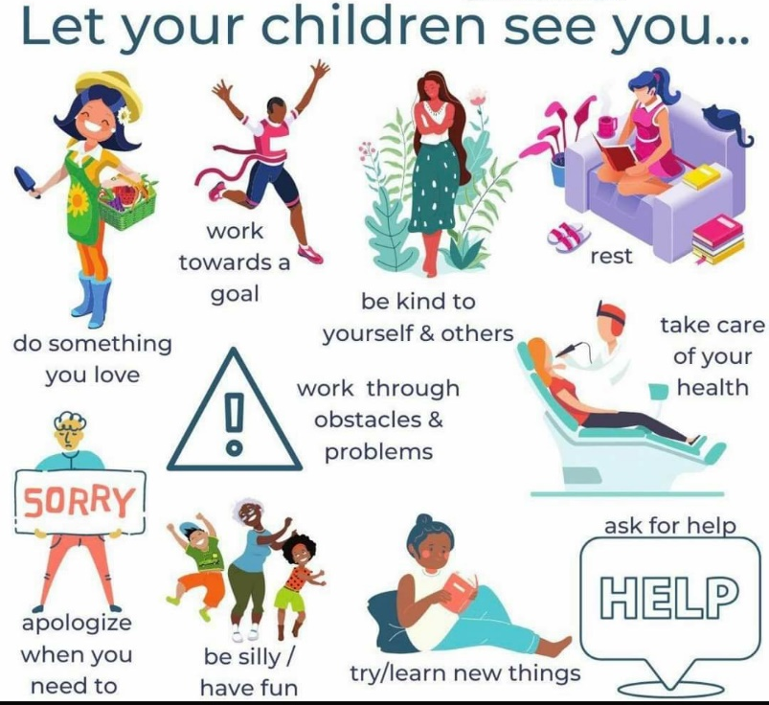
Role Modelling
Notes:
The best way your child can learn to look after their mental health and wellbeing is by watching you!
Model how you look after your emotions and mental health – explicitly talk about it. If you struggle with your mental health or not, we will all do things each day that support our Mh and wellbeing
Talk about and express your emotions Infront of your child, but also model how you look after them. example: stressed, go for a walk
Children Benefit from having imperfect parents.
Activity: Asking parents to consider what they might do to look after their own wellbeing
Discuss what you do for ‘self-care’ – and explicitly tell your child that’s why you are doing it.
However: Be careful to reinforce to your children that they aren’t responsible for your feelings
Make sure you are supported too.

Slide 31
Managing BIG feelings
Don’t talk to me! I can’t think straight right now.
I’m feeling a bit overwhelmed. I’m not ready to talk yet.
I’m calm and able to reflect. I’m ready to talk now.

Slide 32
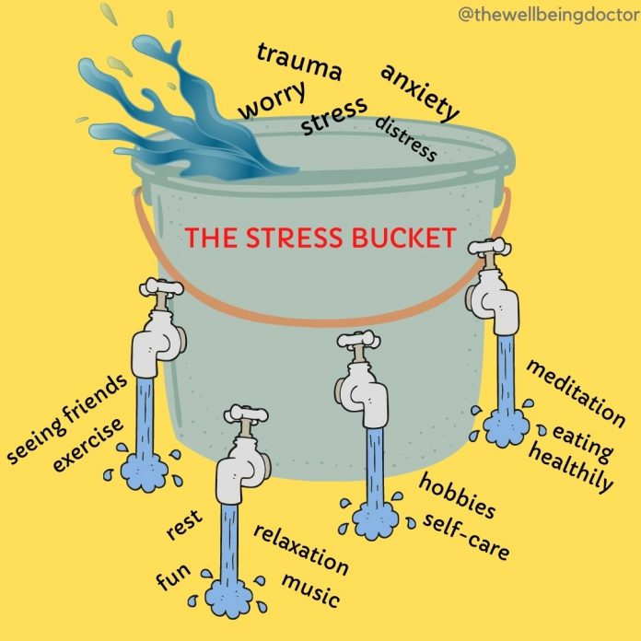
Notes:
We can start to support our children to build a wellbeing tool box – a range of ways they can support their mental health and emotions – for different circumstances.
Consider these questions for yourself and then for your child. You could even ask them these questions, to get a good idea of what strategies they would like to use at home, and at school.
Take a moment to decide what works for you?

Slide 33
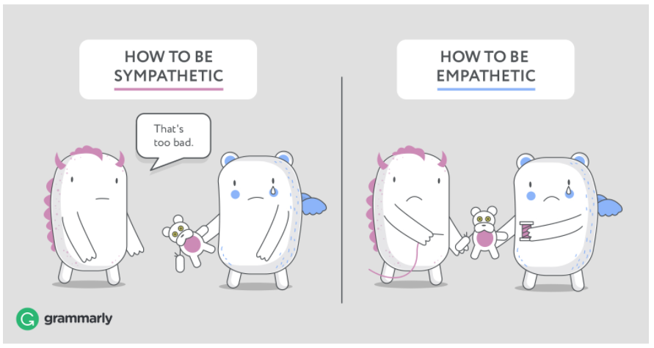
Empathy vs Sympathy
Notes:
https://www.youtube.com/watch?v=1Evwgu369Jw

Slide 34
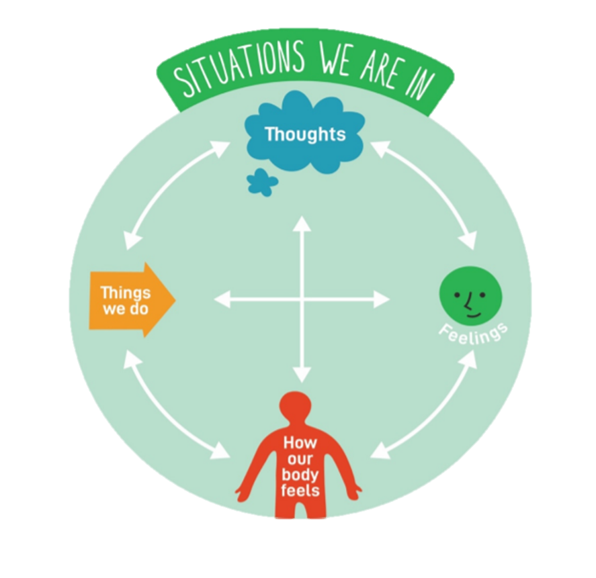
Behaviours:
Seeking reassurance
Avoidance
Being quiet/ withdrawn
‘acting up’ – behaviours of distress
Crying
Picking skin. Biting nails
Increase in fidgeting, legs shaking, trembling
Struggling to focus
Thoughts:
Worries
Negative thoughts about the anxiety
About the ability to cope
Other people’s perceptions.
Bodily Sensations:
Headaches
Tummy aches
Sweaty palms
Heart beating fast/hard
Dry mouth
Feeling sick
Feelings:
Worried
Upset
Stressed
Angry
Numb
Confused
Irritable

Slide 35
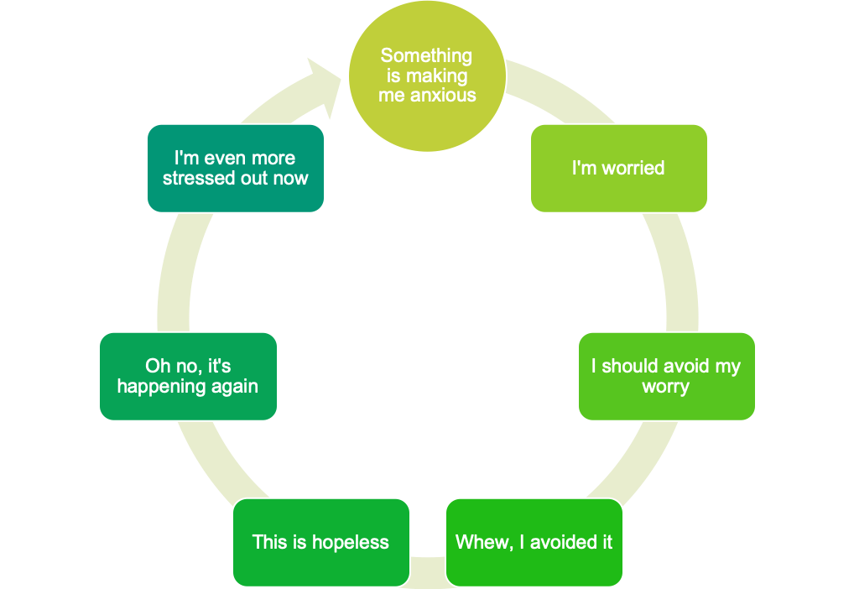

The Cycle of Avoidance
The anxiety feels worse because we have not learnt to cope with it
Worry goes unchallenged and we don’t know what to do about it
The trigger may never go away, but we can change how we manage our feelings about it
Avoidance causes short term relief reinforces the anxiety but eliminates a learning opportunity

Slide 36
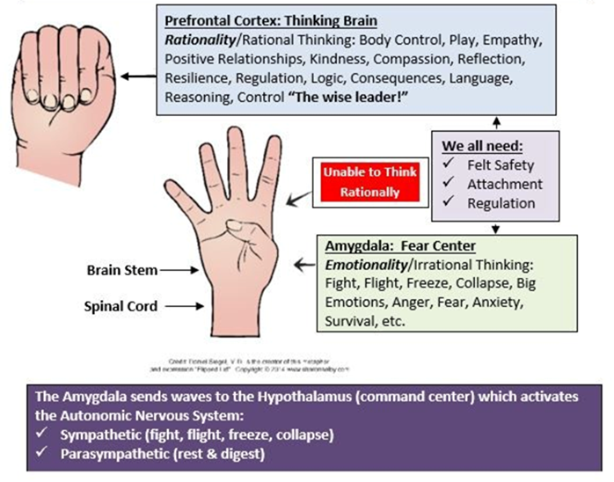
The Hand Model
Notes:
Optional Video: Amy Harper introduces the Hand model of the brain Brilliant Brain, Hand Model - Amy Harper on Vimeo

