Slide 1

Meet the Teacher
Welcome from
Mrs Smith, Mrs Bell, Mrs Souto & Mrs Ferguson
Mrs Kidner, Ms Mitchell and Miss Downs are the Year 2 Teaching Assistants

Slide 2
School timings
Children come into the class room from 8.45 and should be in class by 9.00am.
They will be marked late or an unauthorised absence after that time.
If your child will not be in school, you need to ring the office to let us know why. If we do not receive contact we will phone home to discuss.
CB

Slide 3
Seeing the teacher
We will be on the door in the morning for any quick messages.
For a longer conversation, we are usually available at the end of the day or you can ring the office to make an appointment if you have any concerns or questions.
First Parents Evenings are on 20th & 21st October
CB

Slide 4
Collecting children
Hometime is 3.15pm.
Please ring the office if you are going to be late or you have arranged for another parent to pick up your child.
Please understand that we will not allow another adult or parent to collect your child if we do not know about it (even if the child knows them!)
CB

Slide 5
Attendance
Children need to be in school as we want to give them the best opportunities for learning and things can change quickly.
We want children to feel confident that they are keeping up.
Good attendance is rewarded for the class and individuals. (Attendance cup and team points.)
If overall attendance drops below our school target of 97% we will start to discuss how we can work together to help improve your child’s attendance.
CB

Slide 6
General Reminders
Uniform
Names in clothes
PE – a part of the National Curriculum, on a Wednesday. Earrings to be removed at home.
Jewellery
Hair
Water bottle - named
CB

Slide 7
Behaviour
Children will be rewarded for good behaviour:
House points
Star of the week
Head Teacher’s award
Board of Excellence
Behave your best
Notes home
CB

Slide 8
Homework
This will go out on a Friday – it will either have a Maths, English or Topic focus, it also will include spellings based upon what we are learning.
The orange homework book should be handed in on the following Wednesday.
Homework club is available on Wednesdays for those who did not manage to do it at home.
CF

Slide 9
Reading at home:
Daily reading with your child – this means re-reading the book. It builds confidence, familiarity and reading skills, fluency and expression.
Please sign the reading record book when you have read with your child. You don’t have to make a lengthy comment each time – a date and initial is fine!
Please make sure the reading book and reading record are in school every day. We need to read with your child too!
CF

Slide 10



How else you can support:
Arithmetic practise and basic maths skills.
CF

Slide 11
Accelerated Reader
As children go through Year 2 they will gradually move onto the Accelerated Reader Scheme.
Book level determined by a Star Test that they will mostly sit over next few weeks.
They move through the levels by reading the whole book twice (or once if it’s longer!) quizzing at the end.
The book may seem easy but it’s the comprehension that is important – if they are getting less than 80% on quizzes they won’t be ready to move up.
CF

Slide 12
Interventions
We aim to support anyone struggling with the day’s lessons through an instant intervention.
As we get to know children, we will address specific needs with different interventions to support them. E.g Maths and Phonics.
CF

Slide 13
Volunteers
If you have time we would appreciate volunteer support in school.
Volunteers play an important role and can help with listening to children read, support in class, going on trips/ swimming sessions etc.
If you are interested, please collect an application form from the Office, then Mrs Evans will meet with you before we complete a DBS check before working with children.
CF

Slide 14
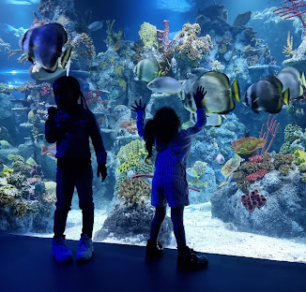
Trips
Education trips will occur through the year.
Bristol Aquarium Tues 24 Nov
You can pay in instalments through ParentPay.
CS

Slide 15
After school clubs
Clubs starting soon.
Please inform us through the office if your child wants to stop attending a club or cannot attend a weekly session.
It is important teachers know who will be attending clubs each week.
Please collect your child from outside the class where the club is held.
If they are at a sports club they should be collected from the other side of the hall – via the KS2 gate.
CS

Slide 16
Medicines
If your child needs to take any medicine, please complete relevant paper work, which can be obtained from the office.
The school will consider whether we are able to administer the medication and liaise with you.
Please let us know of any medical changes.
CS

Slide 17
Pastoral Care and Support
We have an experienced pastoral team in school who can offer a variety of support to our children and families if they are in need.
Family Support Worker- uniform, money, debt, housing, foodbank, bereavement, parenting advice.
SENDCO- Concerns about special educational needs and medical needs.
Learning Mentor- delivers interventions around emotional literacy support and social skills, accessing learning, Lego Therapy, Forest School and Draw and Talk
CS

Slide 18
What are we working towards this year?
CS

Slide 19
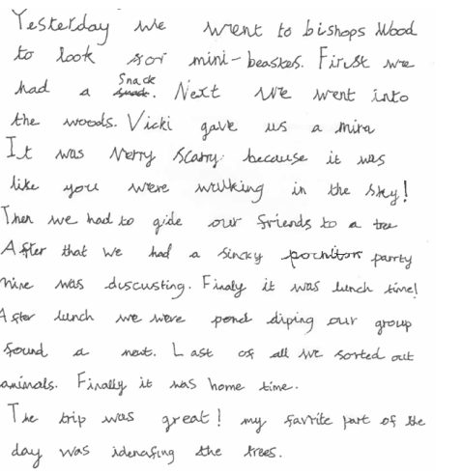
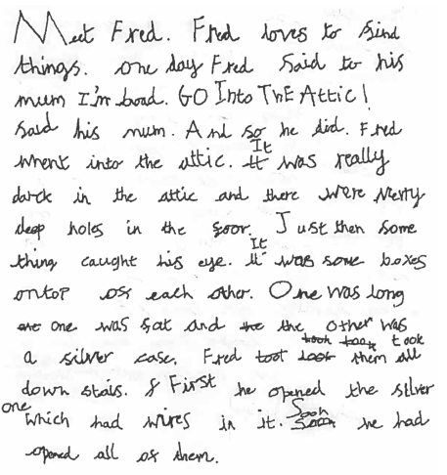
English
Reading & Writing
Capital letters, full stops, question & exclamation marks commas in lists, apostrophes
Adjectives & description.
Conjunctions – and, but, so, because, if, when
Starting sentences in different ways.
To spell words more accurately and not just rely on their phonics.
Joined cursive writing.
CB

Slide 20
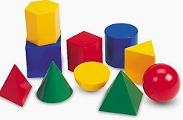

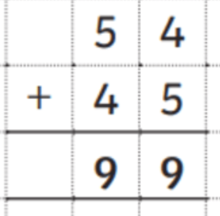
Maths
Times tables – x2, x5, x10, (x3)
Add & subtract numbers to 100
Solve multiplication & division problems
Identify halves, thirds & quarters, find simple equivalent fractions and fractions of amounts.
Measure and compare weight, length & capacity
Tell the time to o’clock, half past, quarter to & quarter past
Name and describe the properties of 2D & 3D shapes
CF

Slide 21
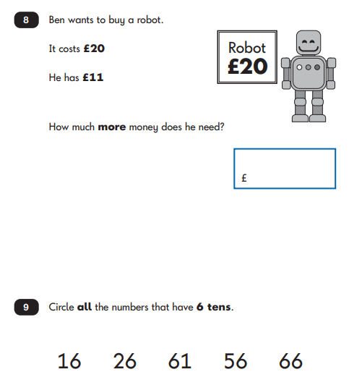



Example SATs questions
CF

Slide 22

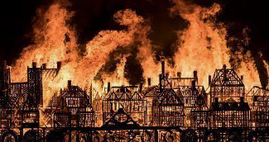
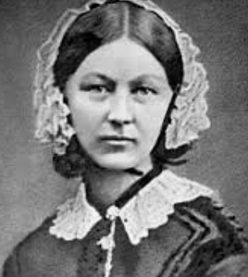
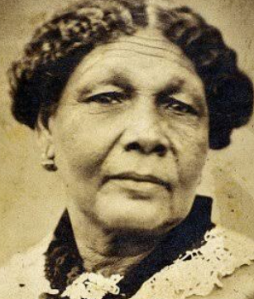

Topic
The children have Science, History, Geography, RE, PSHE, Art, DT and Music lessons.
Term 1 – Jambo/Kenya
Term 2 – Fire! Fire!
Term 3 – Florence Nightingale & Mary Seacole
CS

Slide 23
Any questions?

